Slide 1
Sales Superstore

Slide 2
Objective
To contribute to the success of a business by utilizing data analysis techniques, especially focusing on time series analysis, to provide valuable insights and accurate sales forecasting

Slide 3
Description
The objective can be broken down into the following detailed components: ➡ Dashboard Creation: Identity the KPI's, design an intuitive and visually appealing dashboard, add interactive visualizations and filtering capabilities to allow users to explore the data at various level of granularity. ➡ Data Analysis: Provide valuable insights to business entities regarding the effectiveness of their sales strategies through visualization and charts ➡Sales Forecasting: Leverage historic data and apply time series analysis to generate sales forecast for next 15 days. ➡Actionable Insights and Recommendations: End goal is to share valuable insights and actionable information that can drive strategic decision-making and support the supermarket's goal for growth, efficiency and customer satisfaction

Slide 4
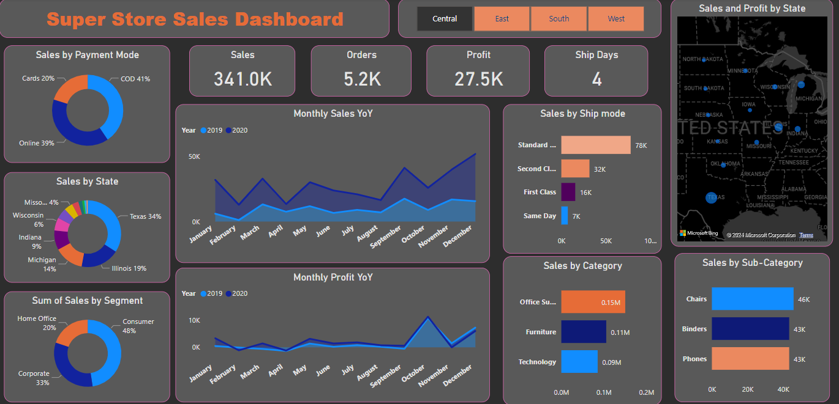

Slide 5
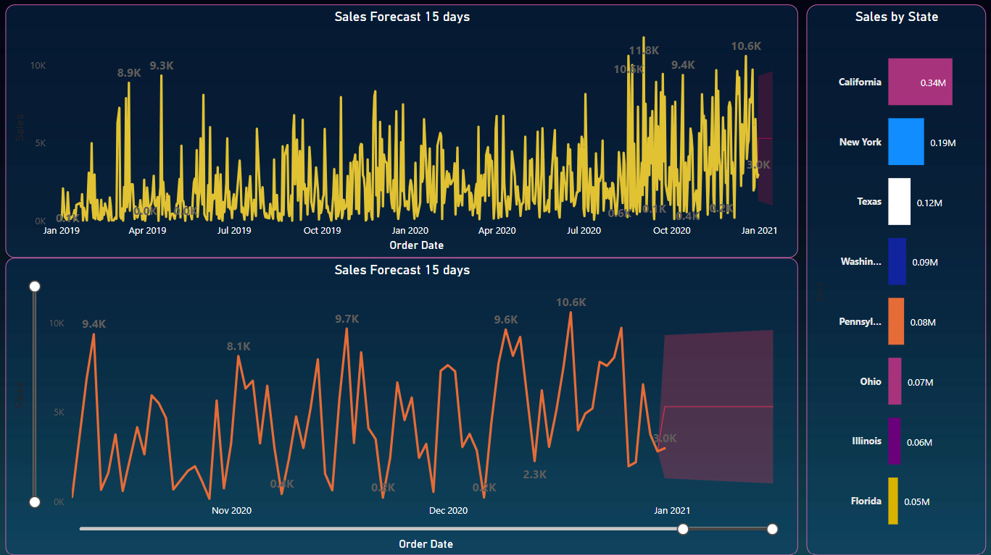

Slide 6
Learnings :
Incorporated data analysis techniques, specializing in time series analysis, to deliver valuable insights, accurate sales forecasting, and interactive dashboard creation, driving business success.

